Slide 1
Agile business analysis Sprint 1
David Studer, Laura Seiler & Soyhan Parlar

Slide 2
Content
1 – understanding the problem
2 – solution
3 – make decisions
4 – prototyping
5 – put it in front of customers

Slide 3
Start at the end (1)
Define long-term goal (should express perfect future; optimistic hat)
List all questions, risks & assumptions that may come in the way of achieving this goal (pessimistic hat)

Slide 4
Make a map (1)
Simple diagram that shows how the customer moves through the product/service (rough draft of the map)

Slide 5
Ask the experts (1)
Talk to people who are experts on some part of the problem (interview them)
These conversations should help us improve the map
During the interviews we take notes → how might we

Slide 6
How might we (1)
Every note is structured the same:
How might we…do this or that?

Slide 7
Organise HMW Notes (1)
Spread them out and have the group sort them out into different categories
Then, sort out the ones that are the most interesting and useful for building the prototype

Slide 8
Pick a target (1)
Choose one specific target customer
One specific spot on the map
Look at the questions from the morning and look at those that we want to answer in the sprint

Slide 9
Lighting demos (2)
Review great solutions from other industries/companies
One person will give a tour of these ideas
Another person will capture these ideas (drawing of what people liked about the example/idea)

Slide 10
Sketch (2)
Each person is going to work alone
Use four step process:
Take notes
Write down ideas
Crazys 8’s (https://www.youtube.com/watch?v=yz4g87XapQ0)
Finished sketch of solution (mostly words & boxes)
At the end, lay down all sketches on top of each other face down

Slide 11
Teh sticky decision (3)
Give everybody the chance to review the sketches in silent to think about the parts they like/dislike
Structured critique:
Decide which components we should take into the prototype
If you have a lot of great ideas, you can build 2-3 prototypes and compare them (Rumble)

Slide 12
Rumble (3)
Make a specific plan to build the prototype(s)
Plan will be in form of a storyboard

Slide 13
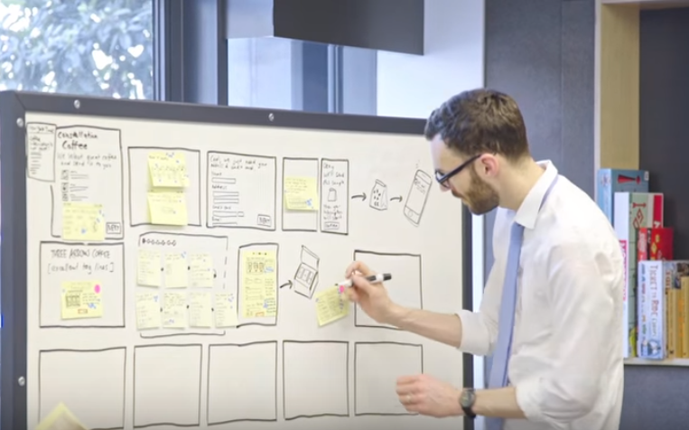
Storyboard (3)
Becomes blueprint for the prototype
Take the sketched off the wall and stick them to a whiteboard to reuse the ideas that are already there, if there are gaps you can fill them in
Do not come up with new ideas, use them ones that the team has sketched

Slide 14
The prototype mindset (4)
You have to believe that no matter what you’re working on that in some way you can prototype it

Slide 15
Build a façade (4)
Something you can put in fron of customers and get their reactions and get answers to your questions

Slide 16
Pick the right tools (4)
Pick the right tools to make a prototype
E.g. keynote

Slide 17
Divide and conquer (4)
Divide up the prototyping (so divide up the storyboard)
Define different jobs:
Writer
Asset collector (e.g. collect stock imagery, etc.)
Stitcher (the one that takes all the individual components of the prototpe and stitches them together)

Slide 18
Trial run (4)
Gather the team together and run through the prototype to make sure it makes sense
Fix gaps if you find anything

Slide 19
Interview (5)
Five one-on-one interviews
Interview them while showing the prototype you have built
Watch their reaction (record the interview)

Slide 20
Learn (5)
The rest of the team is going to take notes while watching the video of the interview
Look for things that went well/not so well in the prototype
At the end of the last interview, put all those notes up on a wall

Slide 21
Look for patterns (5)
Look for patterns
Find those successful parts of your prototype and the parts that aren’t working so well
Look back at Monday’s questions and see which ones you can answer

Slide 22
Make a plan (5)
Make a plan about what to do next
If you took risks during prototyping, there will have been things that did not go so well (e.g. where customers got confused/weren’t interested)
You probably want to run a follow-up sprint (but don’t start from scratch! Start by updating the prototype and testing it again)

